Slide 1
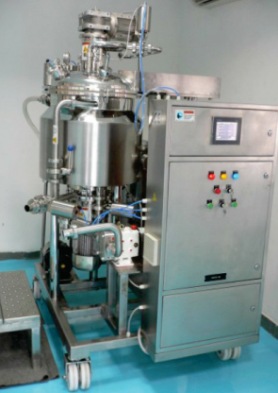
LAB MODEL OINTMENT / LIQUID MANUFACTURING TANK :
Mfg.& Exp. Of Plants & Machineries for Pharmaceuticals,
Cosmetics, Chemicals food & Beverage Industries
Plot No. 1601/1,3rd Phase G.I.D.C., Vapi-396195. (Gujarat)
Email:sales@sidhipharmaequiment.com:sidhipharmaequipments@gmail.com:
Contact Person : Mr. Pravin Panchal (9924893790) Mr. Kiran Gophane (9545868896)
Website: www.sidhipharmaequipment.com

Slide 2
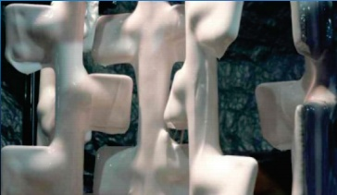
LAB MODEL OINTMENT / LIQUID MANUFACTURING TANK :
Liquid / Ointment Mixer Machine is design as per the vacuum application for de- aeration of mixing container, to remove air bubbles from the product during mixing for GEL products. ( Vacuum system) vacuum pump is not our scope of supply
It is also suitable for preparation or mixing of any liquids on a smaller scale.
Insulation will be provided on jacket of container. The insulation will be covered with Ss304 material in GMP mode
Material discharge from bottom. Flush bottom valve provided for material discharge.
M/C provided with Light glass, Slight glass, material inlet, water inlet, steam & washing water inlet, air suction valve for vacuum, vacuum gauge etc..
Mixing assembly have two speed facility. Variable speed drive facility for mixing assembly will be provided on extra cost, as a Optional facility.

Slide 3
Silent Features :
“PLC” based operating panel for automation.
Variable speed drive for main motor for variable rpm of mixing assembly.
Online sampling port to take sample of product during mixing.
Inline homogenizer.
Hydraulic lifting system for mixing assembly with top disc
Advantageous\ Benefits :
Mixing , dispersing and homogenizing in one operation.
Rapid and effective cleaning : CIP / SIP
High capacity with minimal space requirement.
Simple operation.
Can be fully automated.
Integration into existing process control system.

